Slide 1
Jefferson Township Public Schools
Strategic Plan Update

Slide 2
DISTRICT MISSION
The district will be a leader in academic excellence while developing healthy, well rounded, resourceful students who are positive, contributing members of the local and global community.
DISTRICT VISION
We strive to foster academic excellence by engaging students in meaningful learning experiences that meet the highest educational standards, while supporting every learning style- in a caring, inclusive, and collaborative learning environment, supported by the greater community.

Slide 3
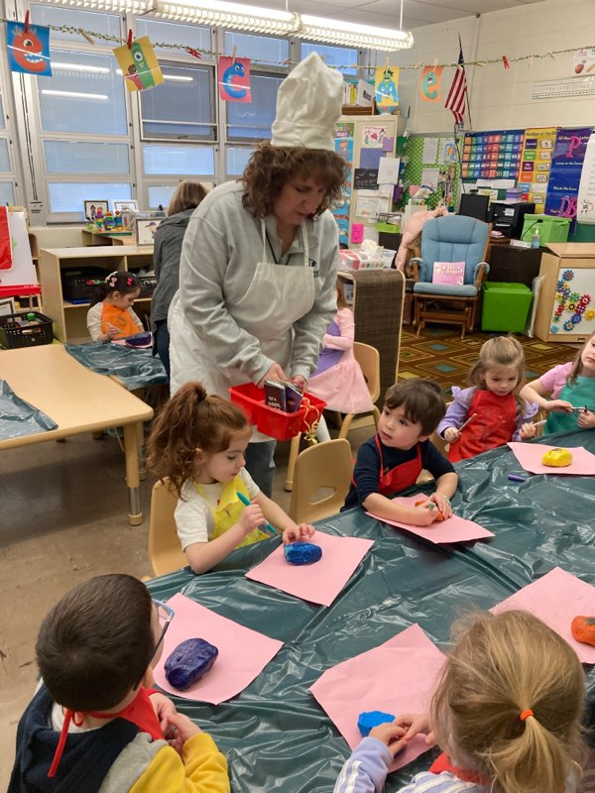
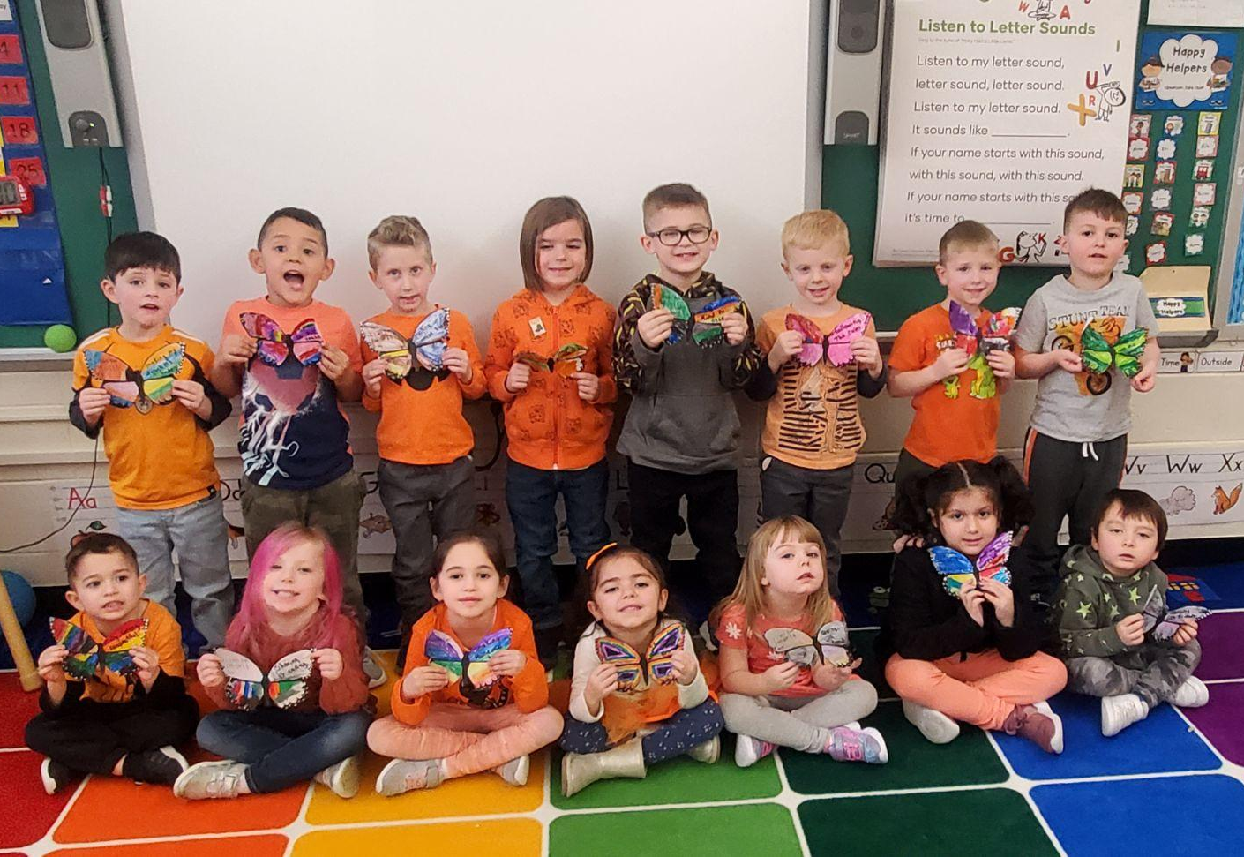
Ellen T. Briggs

Slide 4
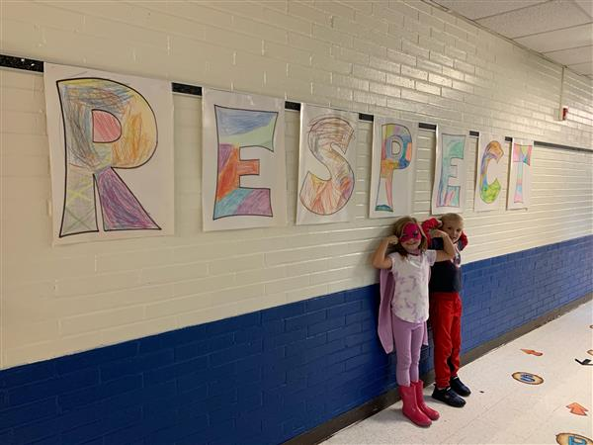
Ellen T. Briggs
Briggs held an SEL day where their young students participated in activities that focused on kindness, empathy, and inclusivity. Mrs. Debrito served as the chef at the Kindness Cafe and students set kindness goals on the wings of butterflies. Goal 2.2- Increase implementation of social emotional learning.
Super Hero Day in the week of Respect

Slide 5
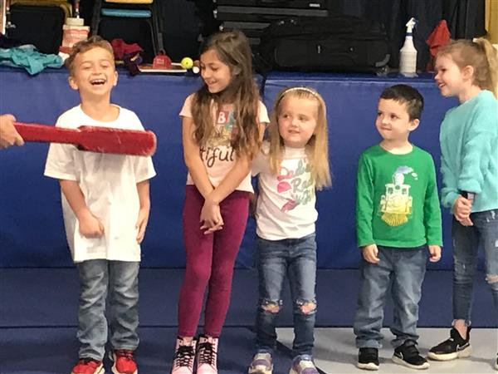
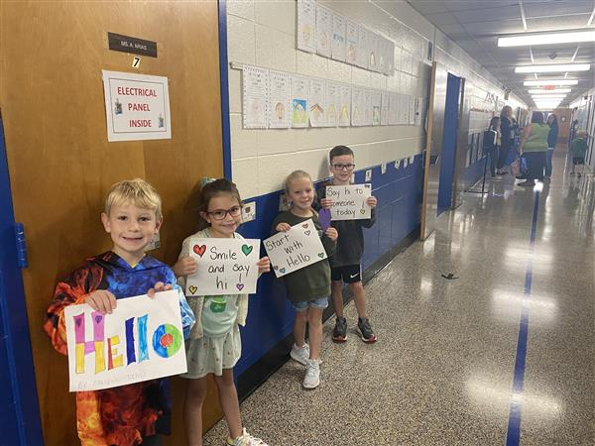
Cozy Lake
Had several professional development training for preschool on things like The Clear Touch TV's, The Creative Curriculum, and Teaching Strategies Gold.
Utilized the Character Strong Program to teach the day to day life skills that the students of Cozy Lake use and learn.
Dentist Visit
Say Hello

Slide 6
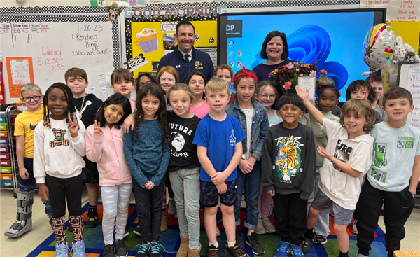
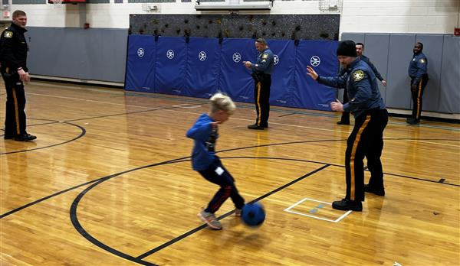
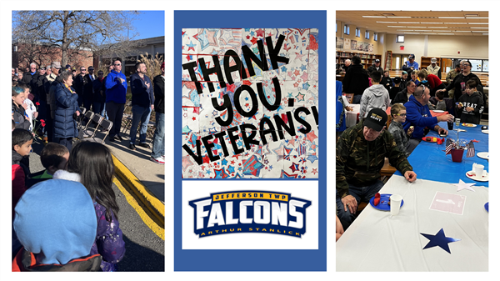
Arthur Stanlick
Kickball with Jefferson PD
Celebrating Mrs Uvino teacher of the year:Goal 2.5
Veteran’s Day Goal 3.3

Slide 7
White Rock
White Rock implemented a positive behavior expectations program called The 3 Be's. The 3 Be's are: Be respectful, Be responsible, and Be safe. This program provides students with clear expectations for behavior and the whole school is working as a team to use this same common language.
We also implemented a recognition program for students and staff called "White Rock Rockstars of the Month". Rockstars of the Month receive a certificate for their achievements and are highlighted on the main entrance bulletin board. Goal 2.5- Increase positive perceptions of school through establishing students of the month.

Slide 8
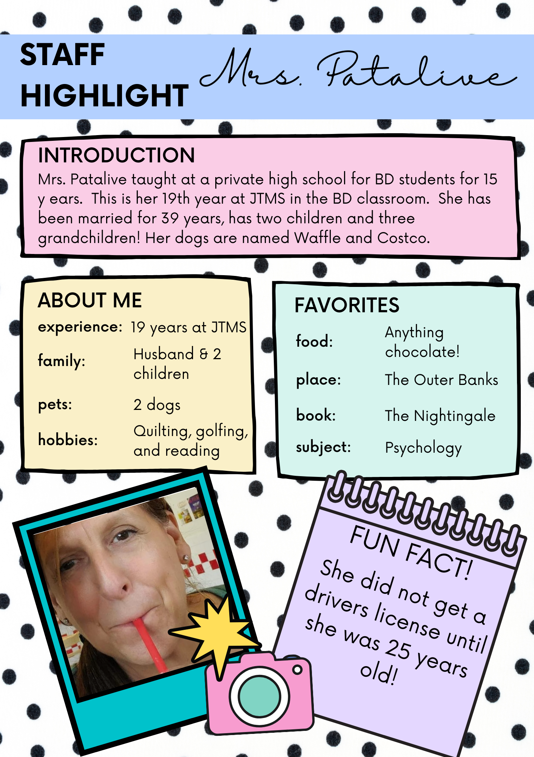
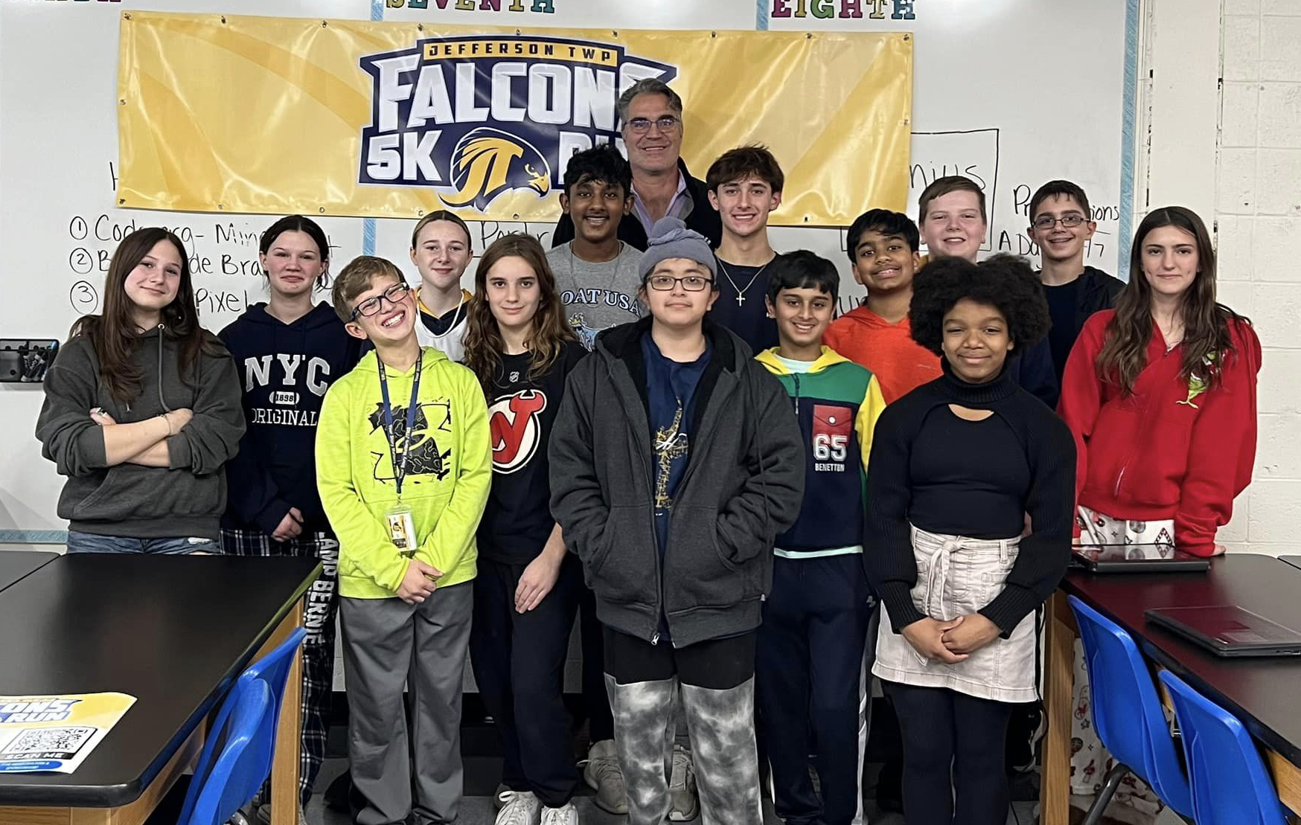
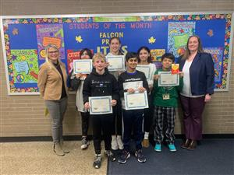
Middle School

Slide 9
Middle School
Assemblymen Barranco visited JTMS and met with Student Council representatives to discuss leadership traits and citizenship. - Goal 3.3 Increase student Civic Engagement
Monthly staff highlights are shared across the building in order to foster positive relationships among coworkers. Students are also nominated on monthly basis recognized for trustworthiness, respect, responsibility, fairness, caring and citizenship Goal 2.5- Increase positive student and staff perceptions.

Slide 10
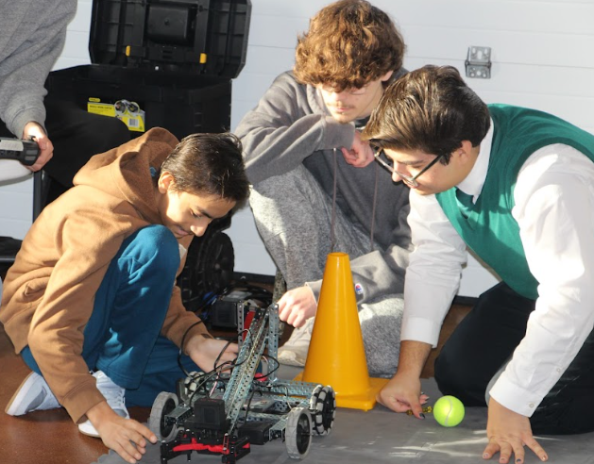
High School

Slide 11
High School
The High school has implemented a Falcon Pride Student Recognition Award. Students that are positive contributors to the school community are nominated monthly by high school staff. Goal 2.5- Increase positive perceptions of school through establishing students of the month.
The high school robotics class and team took part of the Winter Stroll at Camp Jefferson. Students taught the community about the robots and modeled how they work. Goal 3.1 -Increase participation in community service & 4.3- Increase district visibility
Notes:
This year, the faculty at the high school created the Falcon Pride Student Recognition Award to recognize positive student contributions to the school community. At the opening faculty meeting in September, teachers and administration worked together to create a description of the award based on the characteristics we wanted to see in our Falcons, and came up with the following:
"The Falcon Pride Student Recognition Award is given to students each month who best exemplify the characteristics that we as a faculty want to see in our student body. Falcon Pride students treat others with respect and empathy, and work to build a more inclusive learning environment for all. These students are resilient in the face of adversity, and are passionate in their academic and co-curricular pursuits. Falcon Pride students take ownership of and responsibility for their actions, and demonstrate honesty and integrity in their interactions with others. The characteristics of our recipients are Passion, Responsibility, Inclusivity, Dedication, and Empathy."
We also worked with local businesses and community members, introduced the award to them, and solicited donations from the community to honor our student recipients. Each month, the student winners receive a gift card to a local business, a custom "Falcon Pride" t-shirt, and a certificate honoring their achievements.

